Slide 1
Macromolecules
The 4 largest molecules of life

Slide 2
What is life again?
The ability to biosynthesize the 4 major macromolecules
i.e. you can create by yourself- the 4 major molecules of life

Slide 3
Remember those elements necessary for life?
The reason these are necessary for life is because they are the basic ingredients for the macromolecules:
CHNOPS
Carbon
Hydrogen
Nitrogen
Oxygen
Phosphorus
Sulfur

Slide 4
The 4 Macromolecules are:
PROTEINS
NUCLEIC ACIDS
CARBOHYDRATES
LIPIDS

Slide 5
Monomer
A building block for macromolecules
Its like one brick in a brick wall
Each brick is a link to a larger wall full of bricks

Slide 6
Important facts to take note of on macromolecules
FUNCTION
Calories of energy
Chemical Structure
What is the name of its monomer?
What does the monomer look like?
What is the chemical structure of the macromolecule
Examples

Slide 7
Carbohydrates
The energy and structure macromolecules

Slide 8
Carb info
*Carbohydrate Energy: Carbs provide 4 calories of energy per gram
*Carbohydrate function: carbs are simple sugars. Their job is in their simplest form to provide energy, in their more complex form, their function is structural (to help
*Carbohydrate Monomer: Monosaccharides

Slide 9
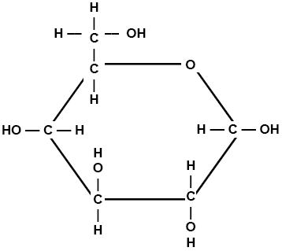
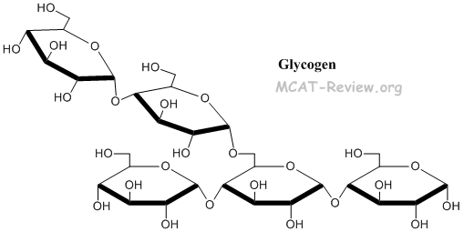
Image of Monosaccharide (the monomer)
Image of Polysaccharide- (The complete Carb)

Slide 10
Carbohydrate Examples:
In Plants
Main Energy Storage: Starch
Main Structural form: cellulose
In Animals
Main Energy Storage: Glycogen
Main Structural form: Chitin

Slide 11
PROTEINS
The Structural and enzymatic macromolecules

Slide 12
Protein info
*Protein Energy: Carbs provide 4 calories of energy per gram
*Protein function: structural, enzymatic, (support, defense, and movement)
*Protein Monomer: Amino Acids-
there are only 20 amino acids that create every protein in your body

Slide 13
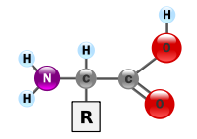
Image of Amino Acid (the monomer)
Image of Polypeptide (The complete Protein)

Slide 14
*Protein Examples:
Enzymatic Proteins: ENZYMES- help lower the activation energy to do chemical reactions, they usually all end in the suffix –ASE some include: helicase, DNA polymerase,
Structural Proteins: hemoglobin is a structural protein in red blood cells.

Slide 15
ENZYMES
Enzymes are special proteins used to reduce the activation energy required for specific chemical reactions within the body
Enzymes are :
Specific
Enzymes are:
temperature dependent- if it’s too hot or too cold they breakdown
Salinity dependent- if it’s too salty they break down
pH dependent- if it’s too acidic or basic they break down

Slide 16
LIPIDS
Hormone, storage and insulation macromolecules

Slide 17
Lipid info
*Lipid Energy: Carbs provide 9 calories of energy per gram
*Lipid function: energy storage, insulation, and membrane structure
*Lipid Monomer: in fats- fatty acid chains

Slide 18
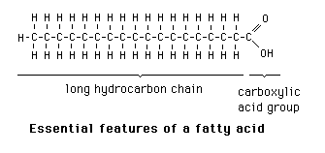
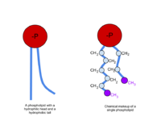
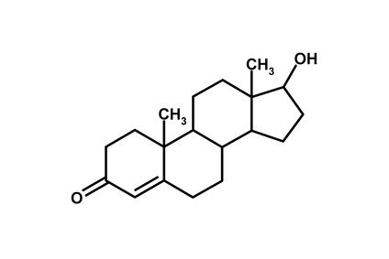
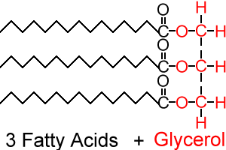
Image of Fatty Acid Chain (the monomer)
Image of each lipid type

Slide 19
*Lipid Examples:
There are three groups of lipids
FATS: saturated, unsaturated, trans fats
PHOSPHOLIPIDS: these are found in cell membranes
STEROIDS: like cholesterol, testosterone, estrogen,

Slide 20
NUCLEIC ACIDS
The information macromolecule

Slide 21
Nucleic Acid info
*Nucleic acid Energy: nucleic acids caloric value is rarely documented or is of little concern some sources say it provides 2 calories of energy per gram
*Nucleic Acid function: materials used for storing the genetic information to create proteins
* Nucleic Acid Monomer: Nucleotide

Slide 22
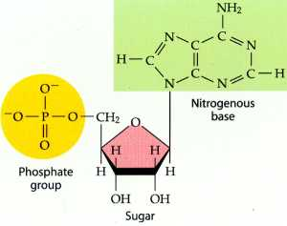
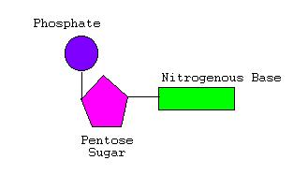
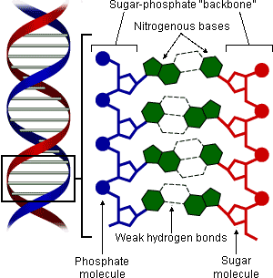
Image of Nucleotide (the monomer):
Image of complete nucleic acid:

Slide 23
* Nucleic Acid Examples:
DNA
RNA

